Slide 1

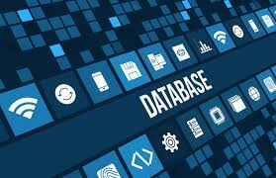
INTRODUCTION TO DATABASE

Slide 2
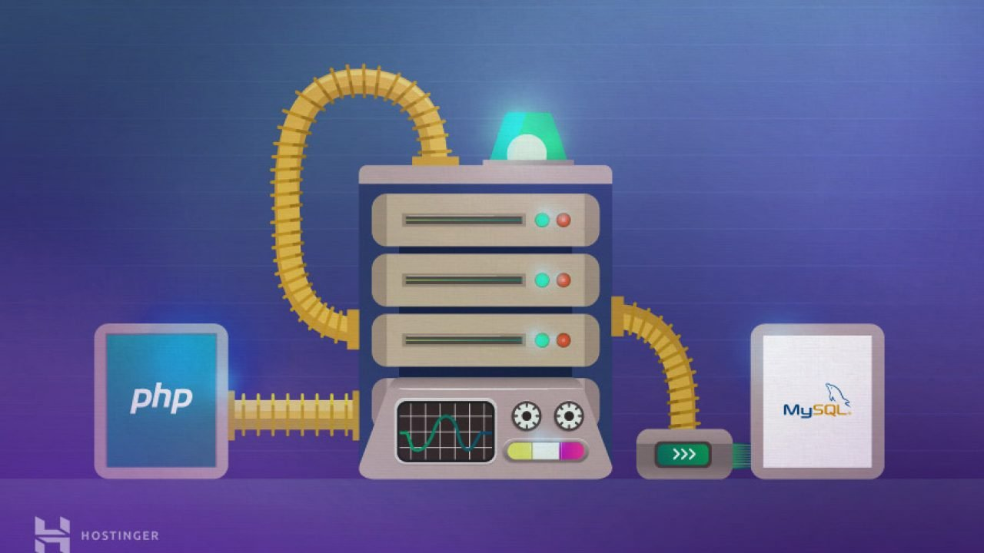
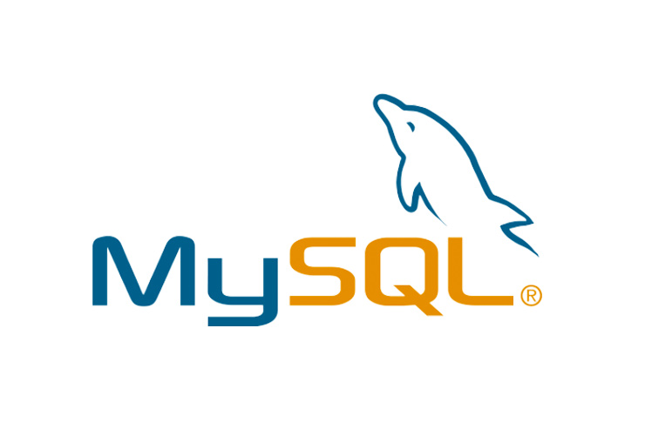
MySQL: Presentation and Functionality
MySQL is a relational database management system. Its role is to store the data, in the form of tables, and to allow the manipulation of this data through the SQL query language.

Slide 3
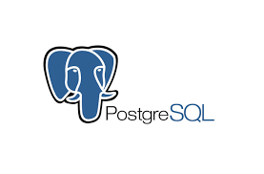

PostgreSQL: Overview and Functionality
PostgreSQL is a powerful and open source object-oriented relational database management system that is able to securely support the most complex data workloads.

Slide 4

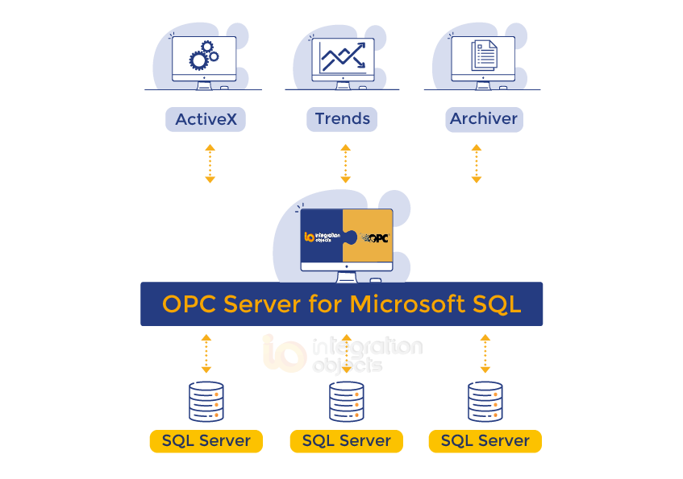
SQLserver: Presentation and Functionality
Microsoft SQL Server is a database management system (DBMS) in SQL language incorporating among others an RDBMS (relational DBMS)
developed and marketed by the company MICROSOFT. It works on Windows and Linux OS (since March 2016), but it is possible to launch it on Mac OS via Doker, because there is a download version from the Microsoft site

Slide 5
Comparison between Mysql, PostgreSQL, SQLserver
MySql : is an undisputed leader among SQL solutions used by google, linkedin, amazon, netflix and twitter.
PostgreSQL: known to support many data types and rich features, and comes
SQLserver: unlike its last two: is a business solution.Fragmentation capacity: this means unifying the database, updating by assigning dex indexes revising the structure by creating new pages.
The SQLserver: offer more defragmentation methods than postgreSQL, they consume less CPU and P provide more flexible parameters.

